Slide 1
Module: Software Engineering
Project Title:
Implement the New Spatial Pattern Learning Experiment
Presented by Team_SqrAS
Nowrin Tasnin Sinthia
Ashraf Uddin
A.S.M. Saiem Solimullah
Fahim Talukder
Supervised By
Prof. Damir Dobric

Slide 2
Table of Content:
Objectives
Introduction
Investigation of Inactive mini-columns
Methodology
Results
Conclusion

Slide 3
Objectives
Analyzing the code of spatial pattern learning.
Investing the reason, why first 40 cycles don't give mini columns list for input 51 to input 99.
Implementation of New Spatial Pattern Learning.
Readable statistical informations about the stability of all mini-columns.

Slide 4
Introduction
HTM
Encoder
Spatial Pooler
Spatial Pattern Learning
HTM is a framework which explains certain structural and algorithmic characteristics of the neocortex consists of Encoder, Spatial Pooler and Temporal Memory.
Encoder is a component responsible for transforming raw sensory input data into sparse distributed representations (SDRs)
The spatial pooler forms SDRs by selecting columns based on input similarity, enhancing spatial patterns while preserving sparsity for downstream processing in HTM algorithms.
Spatial Pattern Learning using Sparse Distributed Representations (SDRs) represents brain's remarkable ability to process and recognize spatial patterns which is based on the fundamentals of hierarchical temporal memory.

Slide 5
Investigation of Inactive Mini-columns
In this experiment, at first, an input is encoded then the encoded value goes to spatial pooler algorithm.
In the spatial pooler algorithm, there are three things happens. Firstly, how many input bits are connected to a single column then that connected inputs are overlapped with encoded values. If the matching crosses a threshold then that column is defined as winner column as well as active column.
After that, that active column will be passed into inhibition function for inhibiting the neighboring columns.
Then, those columns which will not be activated those columns are referred as weak columns and those columns permanence will be boosted.
After investigating, found the problem in the boosting function and idea is reduce the weak columns as fast as possible.
var weakColumns = c.Memory.Get1DIndexes().Where(i => c.HtmConfig.OverlapDutyCycles[i] < c.HtmConfig.MinOverlapDutyCycles[i]).ToArray();

Slide 6
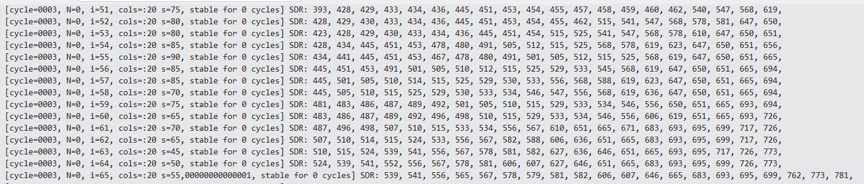
Investigation of Inactive Mini-columns
After tuning with the values of DutyCyclePeriod and MinPctOverlapDutyCycles to see at which value getting the best output. By setting the value of DutyCyclePeriod = 1000 and MinPctOverlapDutyCycles = 0.45, got the best output.
Getting all the inputs active columns from cycle 3. Not only getting the active columns but also stabled faster than before and got stability at 384 cycle.
Figure 1: Getting mini columns for all inputs.
Figure 2: Stability on cycle number 384.

Slide 7
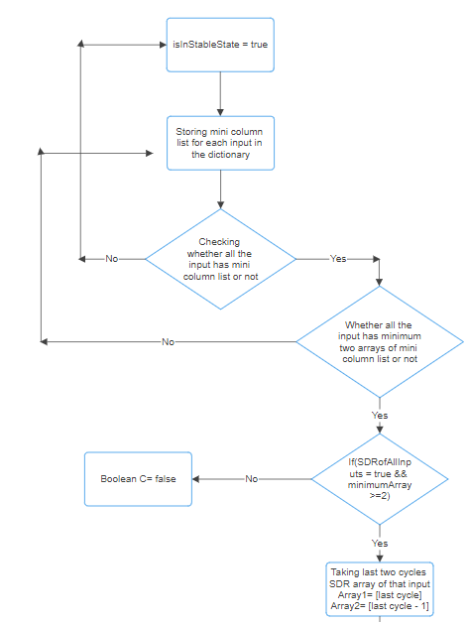
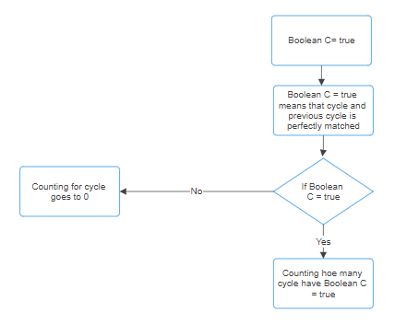
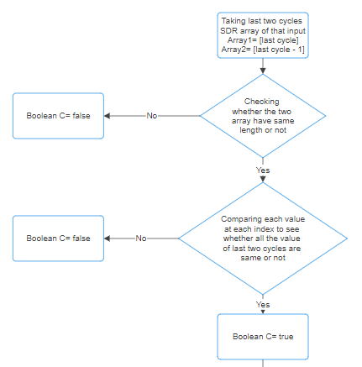
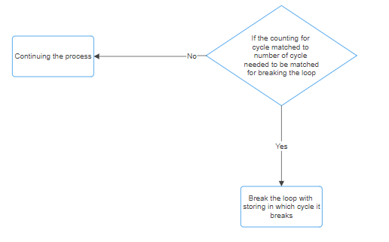
Methodology
Figure 3: Methodology of New Spatial Pattern Learning.

Slide 8
Methodology
After getting stability on 384 cycle, storing the mini columns list of each input in the dictionary.
After the variable isInStableState = true, storing the mini columns list and comparing the mini columns list for another 100 cycles whether there are any change in the mini columns happening or not.
For this, at first, checking whether all the mini columns list of inputs are stored or not.
The variable isInStableState may turn false again so this needs to wait for another 50 cycles because when it becomes false, if similarity is greater or equal to 97% for consecutive 50 cycles, it turns into true again.
That’s why need to clear the SDR arrays of every cycle for each input as well as setting the necessary values to it’s initial value.
After matching all the conditions, started comparing the last two cycles SDR array of each input whether two arrays are fully matched or not.
Doing this for every input for consecutive 100 cycles.
If at some point it doesn’t match even if change of one mini column, setting the variable countForCycle = 0 again.
If and only if countForCycle = 100, program is breaking the loop and printing the dictionary.

Slide 9
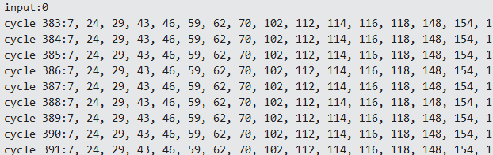
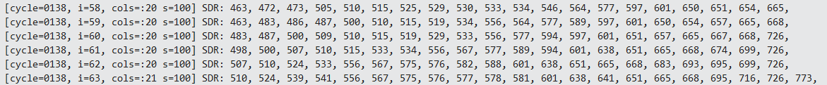
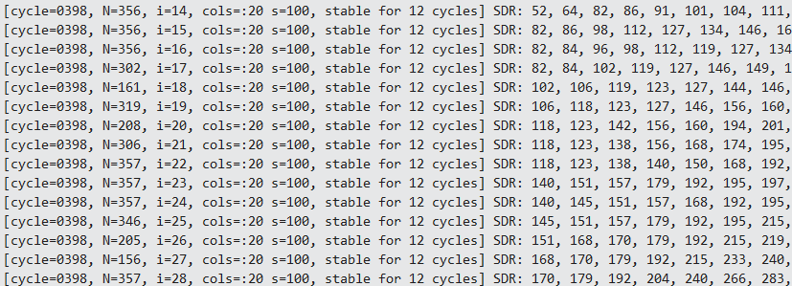


Results
Output of previous and After the new Spatial Pattern Learning Experiment Implementation’s
Printing the dictionary at the end.
Figure 4: Previous output of the implementation Spatial pattern Learning
Figure 6: Printing the dictionary for input (last 100 cycles).
Showing Percentage of how many inputs are stable for every cycle.
Figure 5: After implementing new Spatial Pattern Learning
Figure 7: A cycle is 100% and 97% stable.

Slide 10
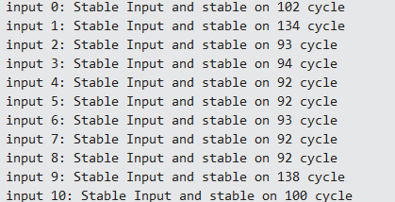
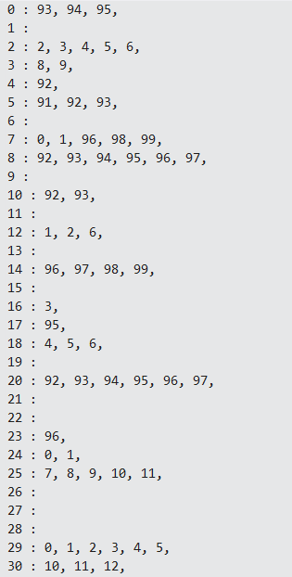
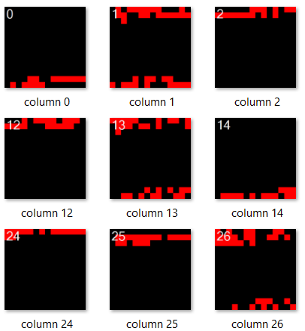
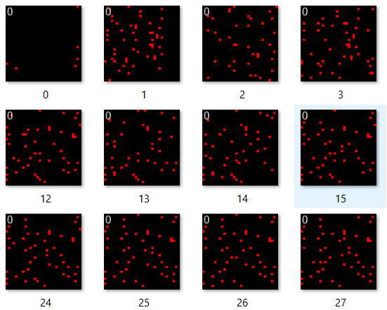
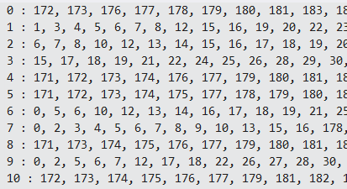
Results
Stability of every input after each cycle
Showing, for which inputs a column will be activated
Figure 8: Stability cycle number for all inputs.
Figure 10: Output of a column will be activated for which inputs.
Generated bitmaps for each input of every cycle. Here is the YouTube link for better demonstration.
Generated bitmaps for the columns whom are connected to the input bits.
Figure 11: Connected input bits for a column and Generating bit maps of connected input bits for a column.
Figure 9: BitMaps of an input for each cycle.

Slide 11
Statistical Informations about the Stability
In the main output adding N = how many iterations the SDR for the input was not changes and after isInStableState = true, counting and showing how many cycles are stable.
After each cycle, showing that whether a input stable is stable or not and if a input is stable then at which cycle it gets stable.
After each cycle, showing by percentage that how many inputs are stable for that particular cycle.
Generated bitmaps for each input of every cycle so that one can easily view how actually the SDRs are changing for inputs per cycle.
Showing for a column will be activated by which inputs. For example, column 0 will be activated for input 93, input 94, input 95.
Generating bitmaps for a column that is connected with the input bits.
Tuned the values of the HtmConfig and gathered information about getting stability at cycle, from which cycle getting all the input’s mini column list and showing this by graph in the google sheet.

Slide 12
Conclusion
After implementing new spatial pattern learning experiment, the code successfully breaks the loop instead of running 1000 cycles.
It ensures that after the variable isInStableState is true, then it’s stability will not change by checking consecutive 100 cycles.
Investigated why first 40 cycles don’t give mini columns list for inputs 51 to input 99 and the reason was the boosting function of spatial pooler algorithm.
Provided readable statistical information about the stability of all mini columns.

Slide 13
Thank You

